Slide 1
The Impact of Opioid Abuse and Proper Prescription Writing of Opioids in a Dental Practice September 26, 2021
Debi Dalton, MD, MBA, RPh, CPE, FAAP, FACHE
Chair, Georgia Composite Medical Board
VP of Medical Affairs/CMO/Physician Advisor Wellstar Douglas Hospital
Secretary, Medical Association of GA

Slide 2
Disclosure
I have no actual or potential conflict of interest and no financial disclosure with relation to this presentation.

Slide 3
Statistics
By 2010, overdose deaths outnumbered deaths by gunshot wounds and MVC’s combined.
By 2016 and 2017, over 120 people died every day in the US from opioid overdoses (more than two people per state per day). By 2019, 38 people died per day due to these overdoses.
6,100 fatal overdoses occurred in the US in 1980 which increased to 8,050 in 1999 but…
By 2013, this increased to 33,090 opioid related overdoses in the US.
And 47,055 fatal overdoses occurred in 2014 with 61% being from prescription opioids.
From 1999 to 2019, nearly 247,000 people died in the US from opioid related overdoses.

Slide 4
Statistics
The number of prescriptions written for opioids had quadrupled from 1999 to 2014. This number has significantly dropped since instituting the PDMP.
Opioid medication sales in the US increased by 300% over the past 10 years.
Heroin and “fentanyl” overdoses were on the rise with the South seeing larger increases for many years. By 2019, the use, abuse and deaths by overdose seemed to stabilize….but the rate is still high.
From 2004 to 2011, Emergency Departments had seen a 114% increase in the number of ED visits due to opioid misuse or abuse: over 1.4 million ED visits in 2011 alone.
Admission rate that was substance abuse related in 2009 was 6 times the rate of 1999.

Slide 5
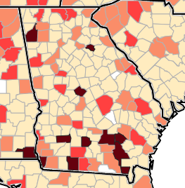
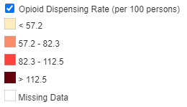
Dispensing Rates for Georgia Map:
Since 2019, this map shows the location of the prescriber rather than the location of the pharmacy that filled the prescriptions.
Darker color represents increased number of prescriptions written: note counties that border other states.

Slide 6
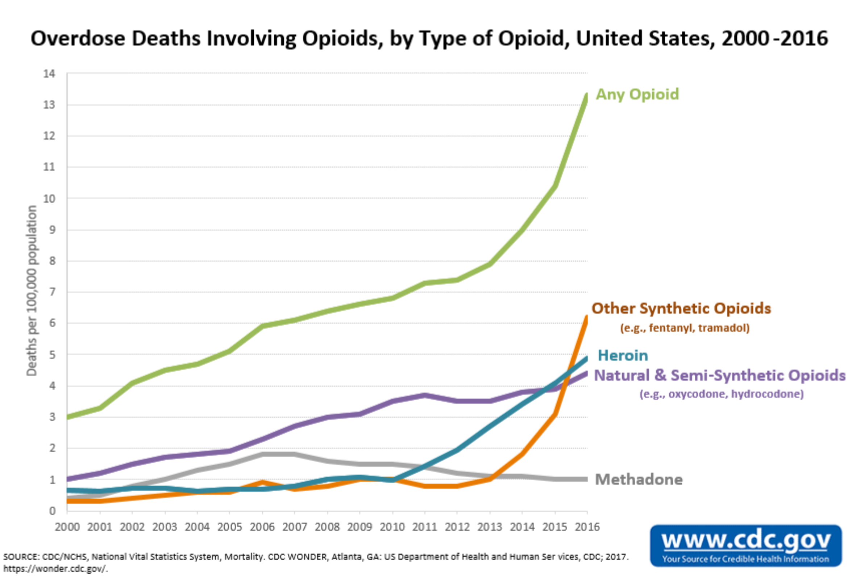

Slide 7
Statistics
Chronic pain patients are as likely to die as are recreational opioid users.
20 to 27% of fatal overdoses are from a patient’s own prescription but the vast majority are from drug diversion.
Fulton County’s opioid overdose rate was more than double the national average in 2014 with Cobb County right behind with fentanyl and heroin adding to the cause of these overdoses.
Opioids were among the top 10 substances named on death certificates.
Patients initially treated with opioids for medical reasons, who later became addicted, turned to heroin and IMF as they were cheaper and more easily attainable on the black market.

Slide 8
Statistics
Opioids involve more than 80% of all drug overdose deaths.
Most of these deaths involved illicitly manufactured fentanyl (IMF).
Total societal costs of prescription abuse, dependence and overdoses in 2013 was $78.5 billion: including healthcare costs, criminal justice costs and loss of productivity, and the cost is exponentially rising.
Insurance carriers report an enormous increase in cost to care for patients due to opioid abuse, dependence and overdose but these number are also on the rise. In just five years, that annual cost increased from $72 million to $722 million. That is an increase of almost 1000%.

Slide 9
The Law

Slide 10
The Law
Establish the PDMP to electronically record prescription information resulting from the dispensing of Schedule II, III, IV or V controlled substances as well as benzodiazepines.
To assist with the reduction of abuse of controlled substances.
To promote the proper use of medications to treat pain.
To reduce duplicative prescribing and overprescribing of controlled substances.
For health oversight purposes.
To gather data for epidemiological research.

Slide 11
The Law
GA HB 249:
PDMP moved from Georgia Drugs and Narcotics Agency to Department of Public Health.
Mandatory enrollment for anyone with a DEA number.
Prescriber can delegate two members of their staff to check PDMP when prescribing an opioid.
DPH will randomly test their PDMP site to confirm operability.
Will include review for opioids, benzodiazepines and certain stimulants.
Go Live for the PDMP review: July 2018
Exemptions include prescriptions for < 3 days supply and no more than 26 tablets, patients admitted to a healthcare facility, OP Surgery patients may have <10-day supply or no more than 40 tablets, terminally ill or hospice patients, oncology patients.
Notation required in medical record that PDMP was checked, and patient was told of the addictive nature of the medication.
Prescriber will be held accountable to the Composite Medical State Board.
All Neonatal Abstinence Syndrome patients will be reported to DPH.

Slide 12
The Law
Effective July 1, 2017, dispensers were required to enter prescription information for Schedule II,III, IV, V controlled substances within 24 hours.
Originally, the law allowed storage of PDMP information for maximum of 2 years. As of July 1, 2019, the storage period changed to five years. At this time, a full five-year record of prescriptions will not be available until July 1, 2022 because the original law remained in effect until July 1, 2019.
Prescriber may be held civilly liable and criminally responsible for misuse of information found in the PDMP. Secure this HIPPA protected information!

Slide 13
The Law
Essentially made naloxone over-the-counter, available in several different forms: nasal, IM and prepackaged 2-pack.
Prescribers shall provide information to patients regarding addictive risks, how to safely dispose of unused opioids, and to provide this information verbally or in writing.
Neonatal Abstinence Syndrome

Slide 14
PDMP
Prescription Drug Monitoring Program
An electronic database which is used to help monitor prescribing and dispensing of controlled substances, specifically Class II, III and benzodiazepines.
If you hold an active DEA number, you must register with the PDMP even if you do not actively prescribe controlled substances.
It is meant to mitigate or eliminate the overprescribing of opioids/controlled substances.
Provides patient medication/prescription history, therefore identifying and protecting those at risk for abuse.

Slide 15
PDMP
https://medicalboard.georgia.gov/professionals/pdmp-information
Provides information and the link to register along with a quick reference guide on how to run a patient search and FAQs.

Slide 16
PDMP
Should be checked when you prescribe opioids if you write a new prescription for a patient for more than 26 pills or for more than 3 days worth of medication.
For outpatient or ambulatory surgical centers: no more than a 10 day supply or 40 pills.
Chronic opioid users have a separate set of rules.
Checking the PDMP can be delegated to 2 other licensed individuals in your practice (per shift or rotation).
Information can be shared with other healthcare professionals involved in the patient’s care.
Regulatory violations will be reported to the appropriate regulatory board.

Slide 17
PDMP
When you check the PDMP - make a notation in the patient’s chart that you did so/include date and time.
Dispensers who fail to observe the requirements of the law will be guilty of a felony and can be imprisoned for not less than one year (but not more than 5 years) and a fine up to $50,000 and action against their license.
Negligently using, releasing or disclosing information from the PDMP is a misdemeanor the first time it occurs but will be a felony upon the second conviction.

Slide 18
Electronic Database Review Advisory Committee
Advises the DPH on establishing, maintaining, and operating the PDMP website.
Reviews data collected, reviews outcomes and benefits of such a review, and communicates to PDMP users.
Comprised of 12 members including a member of the DPH, GCMB, GA Board of Dentistry, privacy matters expert (legal), addictionologist, oncologist, hospice specialist, pain management specialist, pharmacist and others.
Voluntary, 3-year term

Slide 19
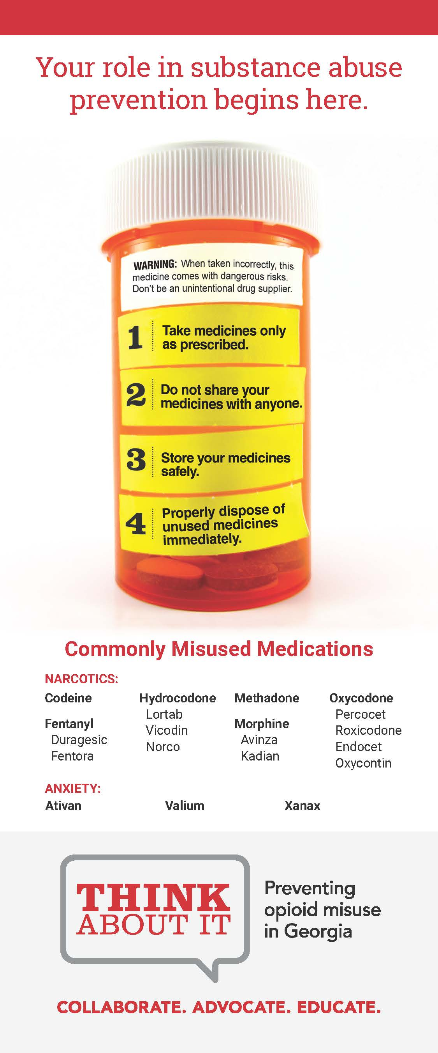
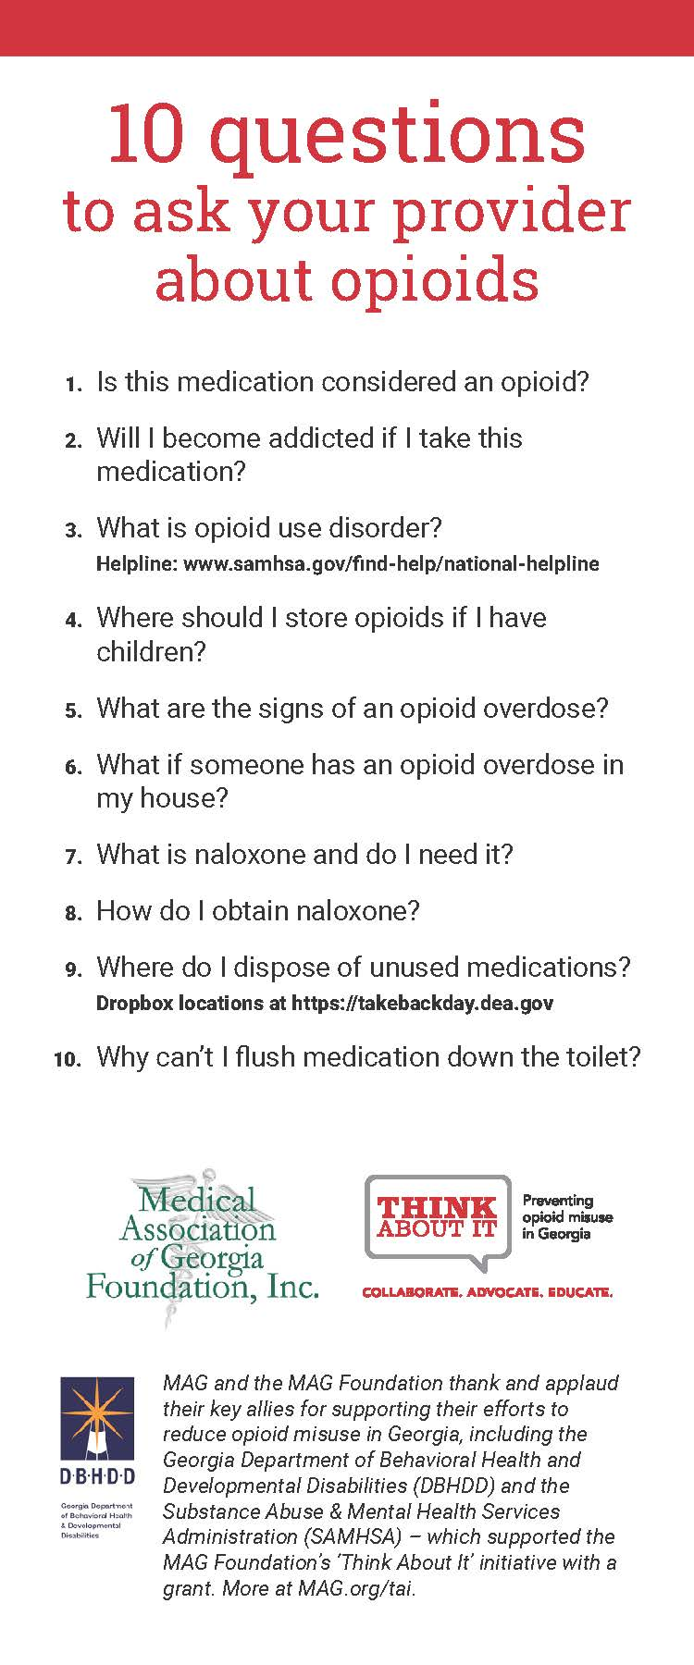
MAG ‘Think About It’ initiative
Patient education
Health care provider education

Slide 20
Prescribing
Minimize prescribing for opioids whenever possible.
When an opioid needs to be prescribed, write for the least amount possible.
Recommendation: do not write for pain medications around the clock.
Space out dosages more and offer NSAIDS in between dosages.
Involve family members and other care takers.
Set the expectations: “your procedure will cause pain afterwards.”
Never set the expectation that the mediations will make the patient pain-free.

Slide 21
For Dentists
Ask patients about previously prescribed opioids.
Discuss with patients how they should take their medications.
Question requests for large quantities of pain medication.
Consider non-narcotic/non-opioid pain medication alternatives and therapies.
Encourage family members to be involved in the patient’s care and medication choices.
Look through your patient’s chart to see how often pain medications have been prescribed.
Talk to patients about the potential of addiction, to not share their prescription medications, and to properly dispose of their unused medications. Encourage dropping off unused opioid medications to local pharmacies, practices, hospitals, law enforcement facilities, or universities.

Slide 22
Resources
CDC https://www.cdc.gov/rxawareness/
AMA Opioid Task Force: https://end-overdose-epidemic.org/
MAG ‘Think About It’ Initiative (leaflets available for patients/providers): https://www.mag.org/affiliates/mag-foundation/think-about-it/
American Society of Addiction Medicine: https://www.asam.org/
Substance Abuse and Mental Health Services Administration (SAMHSA): https://www.samhsa.gov/medication-assisted-treatment/medications-counseling-related-conditions/opioid-overdose
GDA upcoming webinars (CE credit): https://www.gadental.org/education/upcoming-webinars
Georgia PDMP, Naloxone & Medical Amnesty: https://www.mag.org/wp-content/uploads/2021/02/MAG-PDMP-Amnesty-Law-Naloxone-FactSheet-2021.pdf
MAG Fact Sheets: https://www.mag.org/advocacy/advocacy-fact-sheets/
GA DPH Drug Surveillance Unit: https://dph.georgia.gov/epidemiology/drug-surveillance-unit
https://www.optum.com/business/resources/library/managing-opioid-costs-managing-risks.html

Slide 24
Contact Information
despina.dalton@gmail.com
debi.dalton@dch.ga.gov
debi.demestihasdalton@wellstar.org
470-644-5485 office
404-805-4454 cell

